Slide 1

Introduction to Natural Language Processing
Bushra Amjad

Slide 2
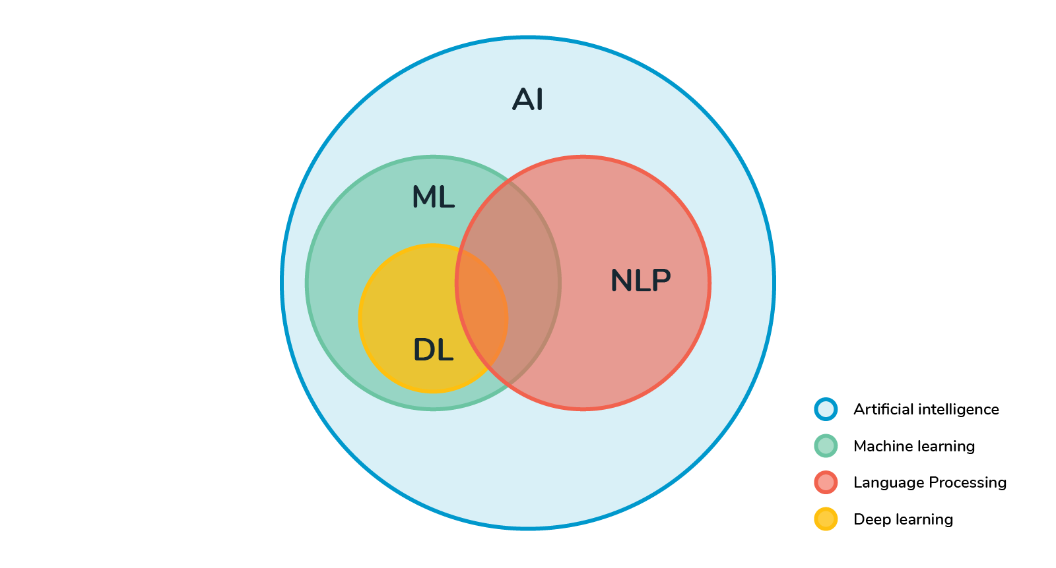
What is NLP?
Natural languages
English, Mandarin, French, Swahili, Arabic, ….
NOT Java, C++, Perl, … (take compilers lol)
Ultimate goal
Natural human-to-computer communication

Slide 3

Examples - Cortana
The Microsoft OS has a virtual assistant called Cortana that can recognize a natural voice.
You can use it to set up reminders, open apps, send emails, play games, track flights and packages, check the weather, etc.

Slide 4

Examples - Siri
Siri is a virtual assistant of Apple Inc.’s iOS, watchOS, macOS, HomePod, and tvOS operating systems
You can do a lot of things with voice commands: start a call, text someone, send an email, set a timer, take a picture, open an app, set an alarm, use navigation etc

Slide 5
Examples - Gmail
The famous email service Gmail developed by Google is using spam detection to filter out some spam emails.

Slide 6
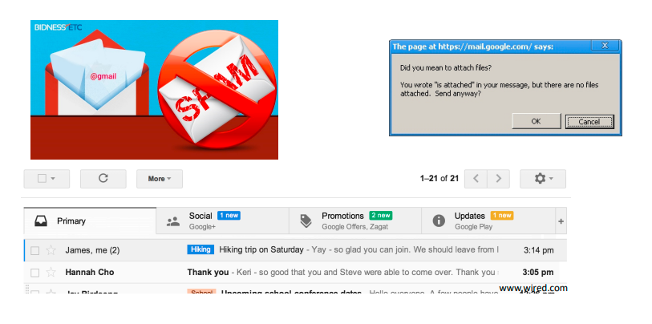
Examples - Gmail

Slide 7
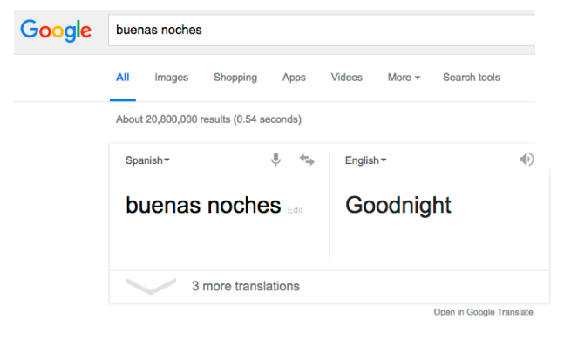
Examples - Machine Translation

Slide 8
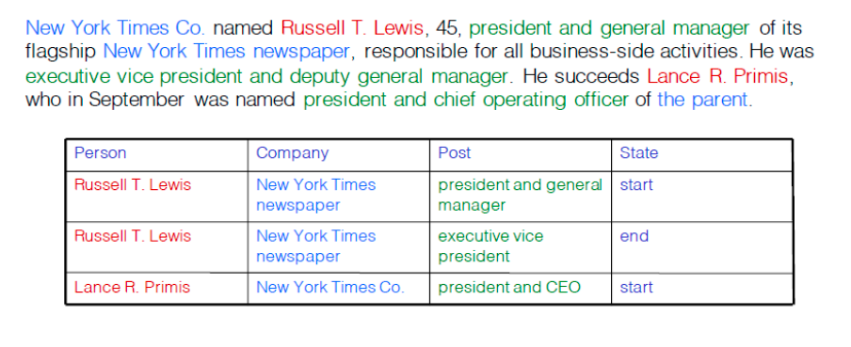
Examples - Information Extraction

Slide 9

NLTK library for Python
It contains a suite of text-processing libraries for classification, tokenization, stemming, tagging, parsing, and semantic reasoning.

Slide 10
Text preprocessing in NLP
Normalization
lowercase, removing numbers, or removing punctuations
Tokenization
Stop Word Removal
Stemming
Lemmatization

Slide 11
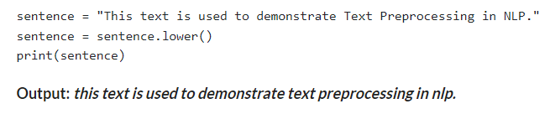
Text Pre-processing Using Lower Casing

Slide 12
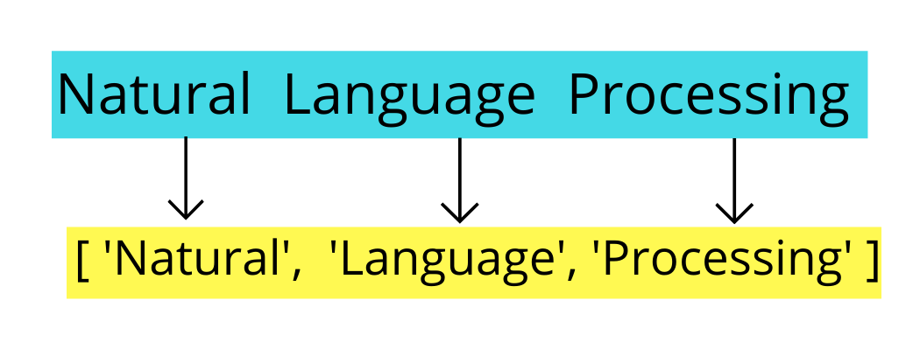
Tokenization In Text Pre-processing

Slide 13
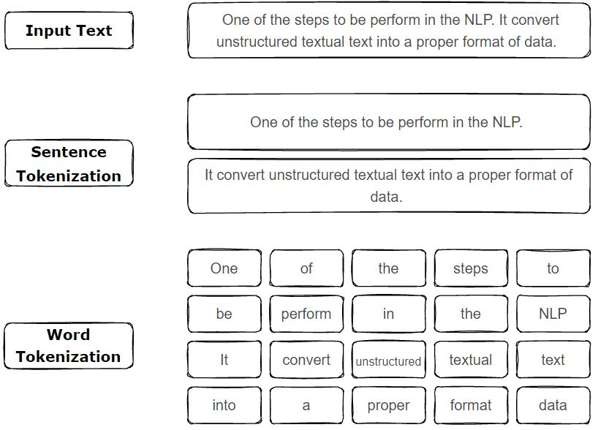

Slide 14
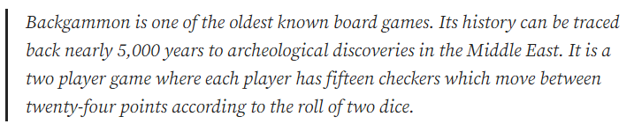
Sentence Tokenization
text = """Backgammon is one of the oldest known board games. Its history can be traced back nearly 5,000 years to archeological discoveries in the Middle East. It is a two player game where each player has fifteen checkers which move between twenty-four points according to the roll of two dice."
import nltk
sentences = nltk.sent_tokenize(text)
for sentence in sentences:
print(sentence)
print()

Slide 15
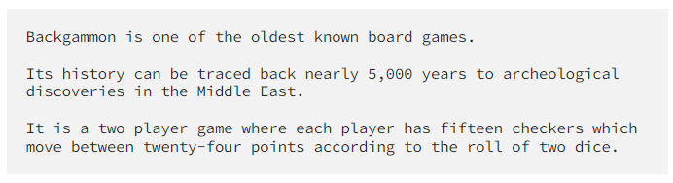

Slide 16
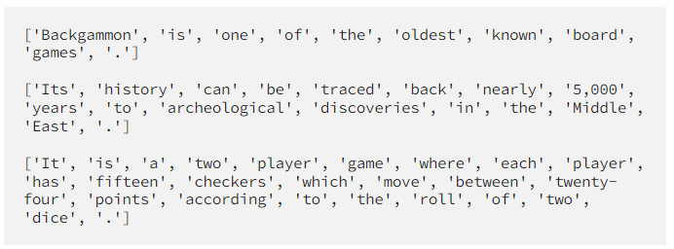
Word Tokenization
for sentence in sentences:
words = nltk.word_tokenize(sentence)
print(words)
print()

Slide 17
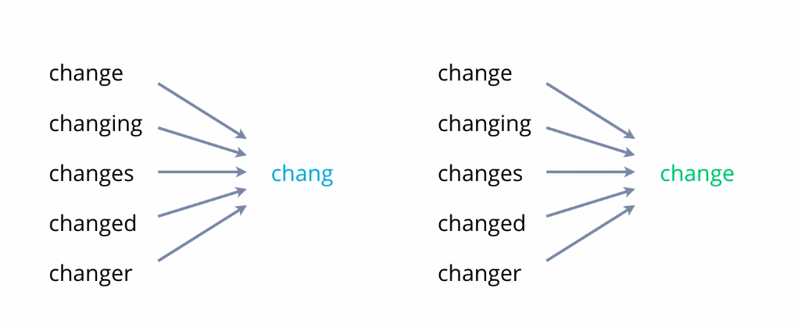
Text Stemming and Lemmatization
Stemming usually refers to a crude heuristic process that chops off the ends of words and often includes the removal of derivational affixes.
Lemmatization usually refers to doing things properly with the use of a vocabulary and morphological analysis of words, normally aiming to remove inflectional endings only and to return the base or dictionary form of a word, which is known as the lemma.

Slide 18
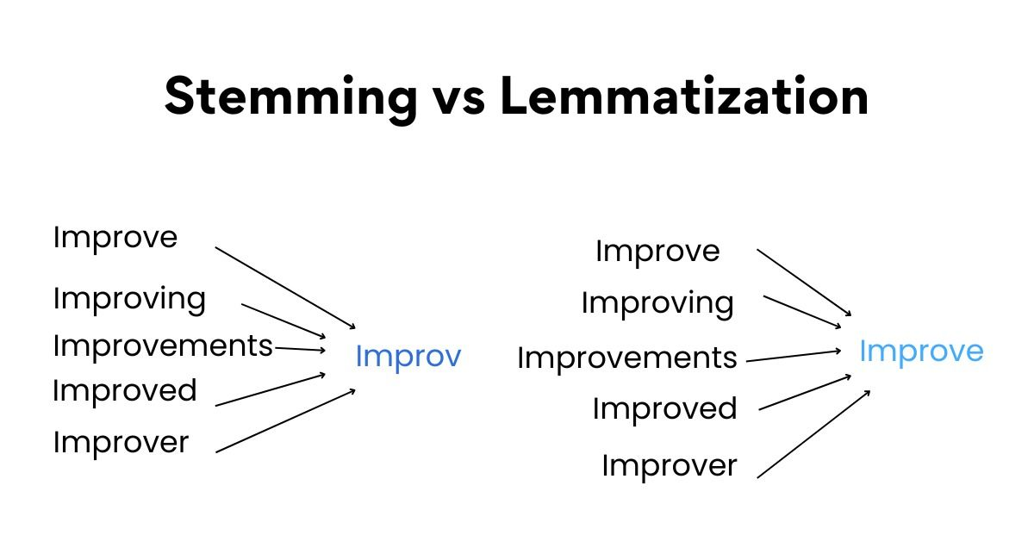

Slide 19
Text Stemming and Lemmatization - Examples
The word “better” has “good” as its lemma. This link is missed by stemming, as it requires a dictionary look-up.
The word “play” is the base form for the word “playing”, and hence this is matched in both stemming and lemmatization.

Slide 20
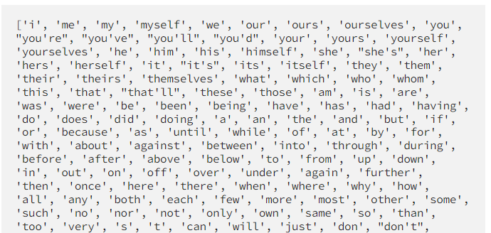
Stop words
from nltk.corpus import stopwords
print(stopwords.words("english")

Slide 21

stop_words = set(stopwords.words("english"))
sentence = "Backgammon is one of the oldest known board games."
words = nltk.word_tokenize(sentence)
without_stop_words = []
for word in words:
if word not in stop_words:
without_stop_words.append(word)
print(without_stop_words)

Slide 22
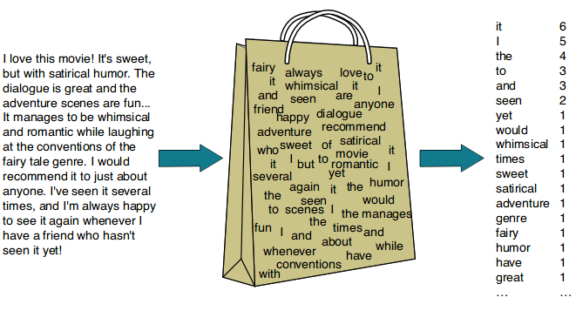
Bag of Words
Notes:
Machine learning algorithms cannot work with raw text directly, we need to convert the text into vectors of numbers. This is called feature extraction.
The bag-of-words model is a popular and simple feature extraction technique used when we work with text. It describes the occurrence of each word within a document.

Slide 23
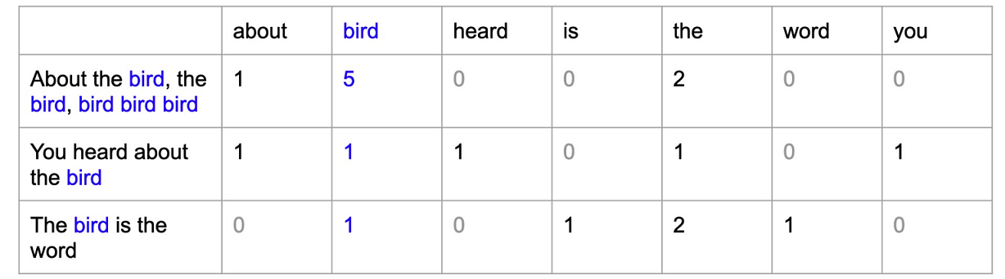

Slide 24
Paragraphs are the building blocks of paper. Many students define paragraphs in terms of length: a paragraph is a group of at least five sentences, a paragraph is half a page long, etc. In reality, though, the unity and coherence of ideas among sentences is what constitutes a paragraph. Topic sentences are similar to mini-thesis statements. Like a thesis statement, a topic sentence has a specific main point. Whereas the thesis is the main point of the essay, the topic sentence is the main point of the paragraph. Like the thesis statement, a topic sentence has a unifying function. But a thesis statement or topic sentence alone doesn’t guarantee unity. An essay is unified if all the paragraphs relate to the thesis, whereas a paragraph is unified if all the sentences relate to the topic sentence. Note: Not all paragraphs need topic sentences. In particular, opening and closing paragraphs, which serve different functions from body paragraphs, generally don’t have topic sentences.

